Slide 1

Linear Regression

Slide 2
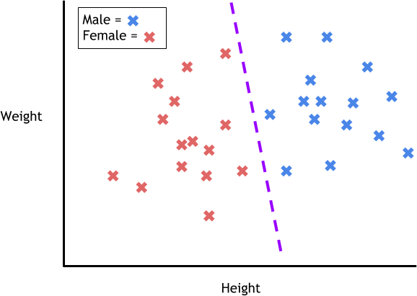
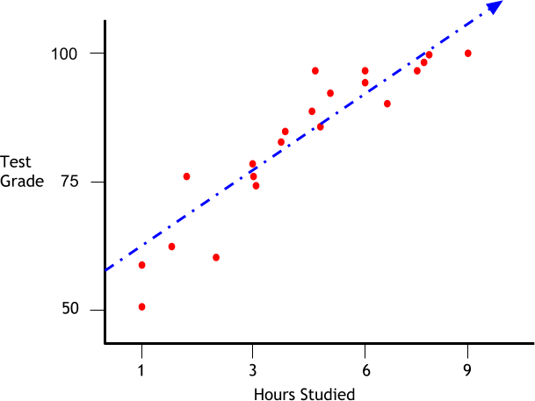
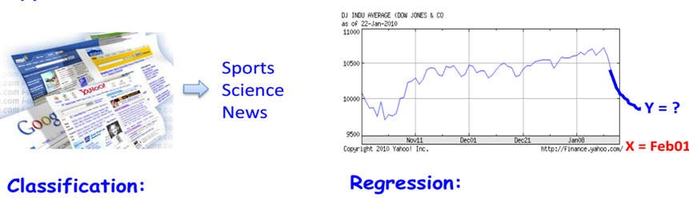
Supervised Learning: Classification vs Regression
Approximate the mapping function y = f(X)
Classification: output(s) is discrete.
Regression: output is continuous or real-valued

Slide 3
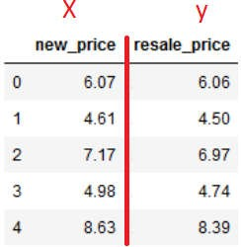
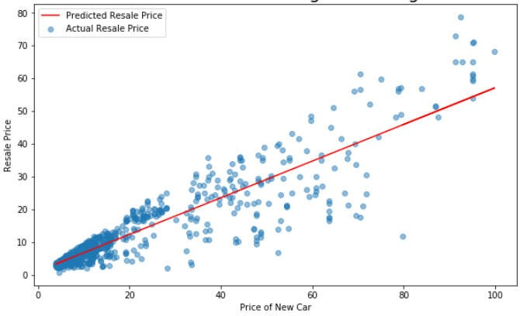



What is Linear Regression?
Linear Regression is a way finding relationship between one or more variables giving the model with the ability to predict outputs for inputs it has never seen before.
Learn
Model and parameters

Slide 4
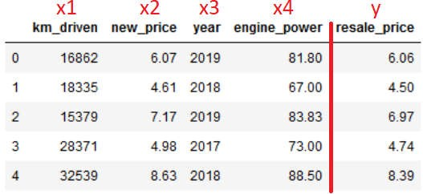
What is Linear Regression?
Model the variable Y in terms of four other variables X1, X2, X3, X4 as Y = f(X1, X2, X3, X4)- multiple regression.
Y is called Dependent Variable or Response Variable
X1, X2, X3,X4 called Independent Variable or Explanatory Variable
Goal: determine the mathematical relationship between response variables Y and regressors Xi

Slide 5

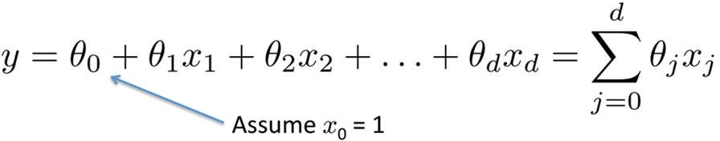
Linear Regression Hypothesis
univariate
multivariate

Slide 6
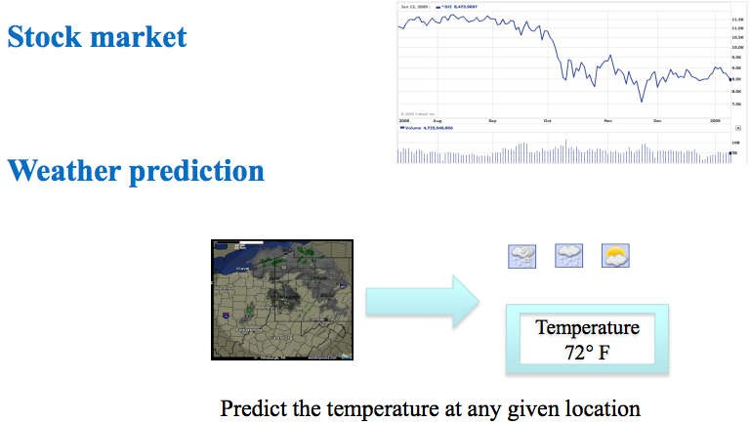
Where can Linear Regression be used?
Understand and quantify the relationship between variables in data

Slide 7
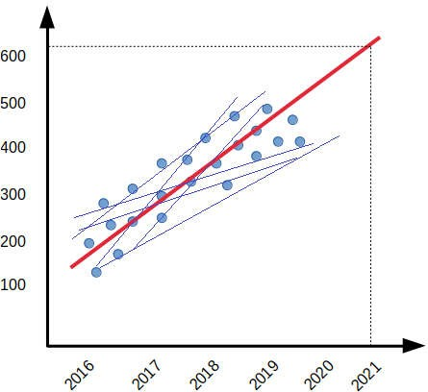
How does linear regression works?
Find best fitting line
For best fit line, error between the predicted values and the observed values is minimum
Define error function as cost function
Learning algorithm find model parameter θ such that it minimize the cost.
h(X) = θ0 + θ 1.X

Slide 8



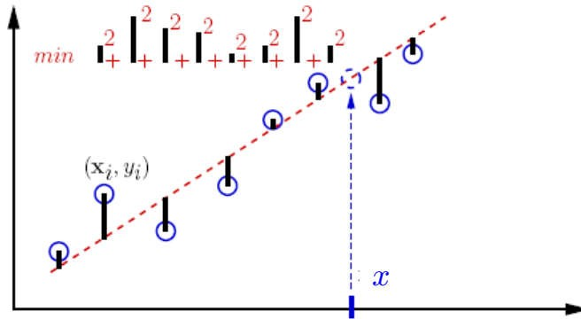




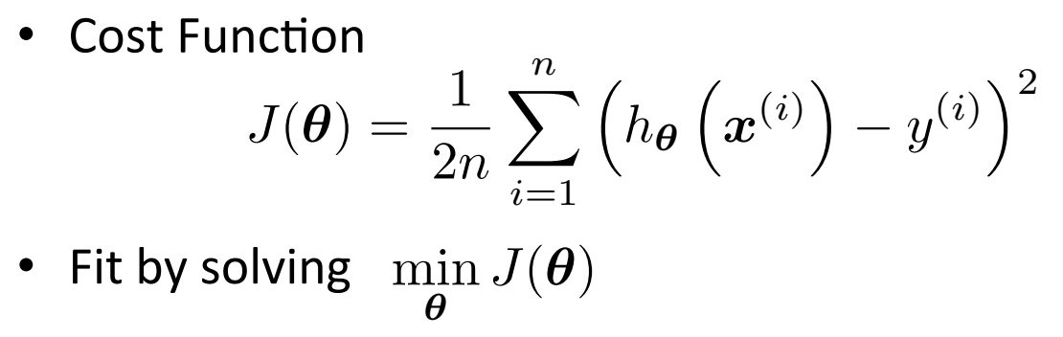

Cost Function
How do we determine the best fit line?

Slide 9
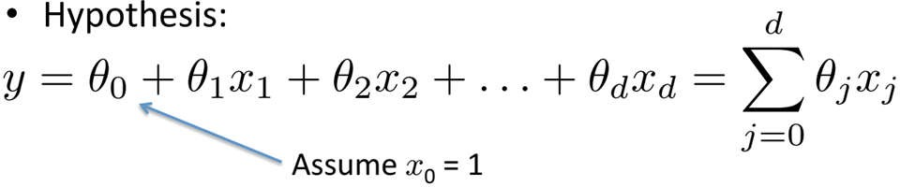

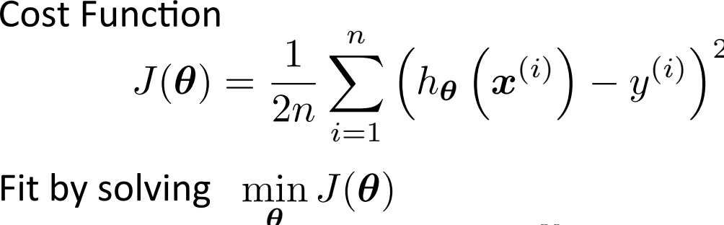
Linear Regression Summary
Data Set : <x1,x2, …, xd, y>

Slide 10
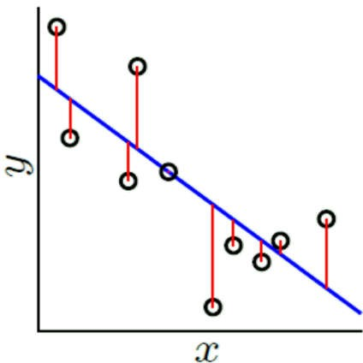
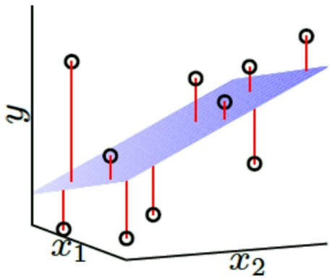
Ordinary Least Square Estimation
OLS Linear Regression Algorithm:
1. From the training data set, construct the input matrix X and the output vector Y
2. Assuming X^{𝑇}X is invertible (positive definite and non-singular),
compute
_{X}𝑇_{X} −1
3. Return θ^ =
_{X}𝑇_{X}−1_{X}𝑇_{𝑌}

Slide 11

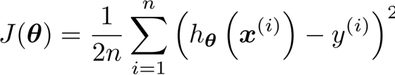



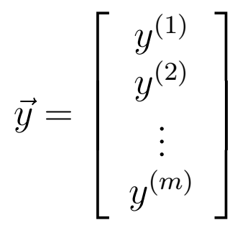

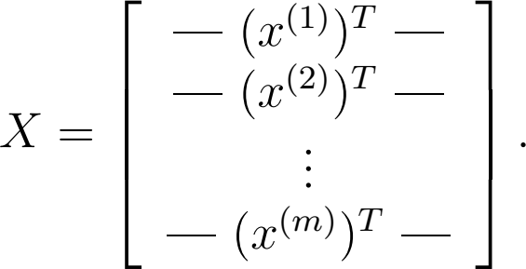



Derivative of Cost Function
Minimize cost function by taking its derivatives with respect to the θj’s, and setting them to zero

Slide 12
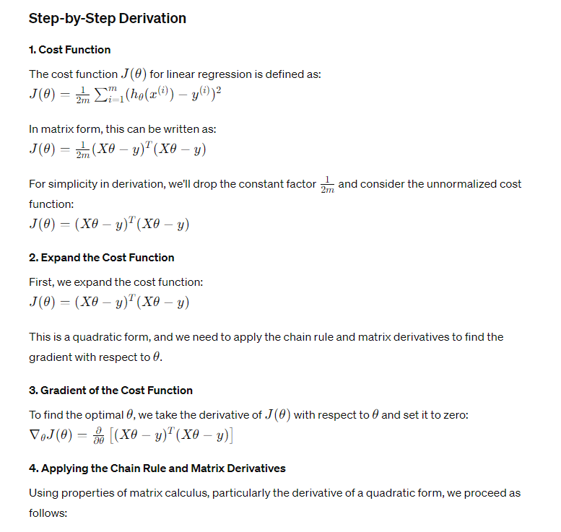
Derivation of OLS

Slide 13
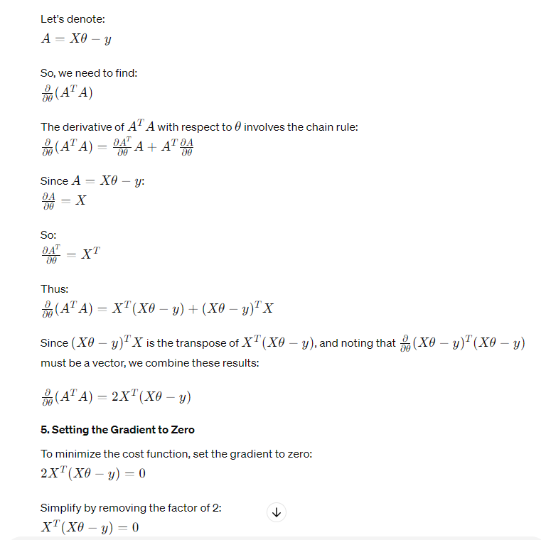

Slide 14
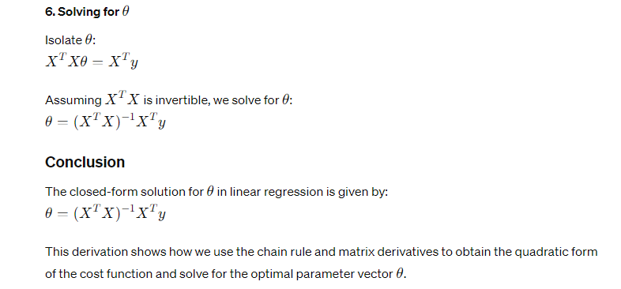

Slide 15
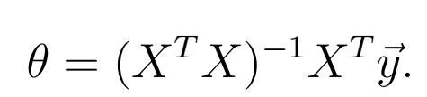
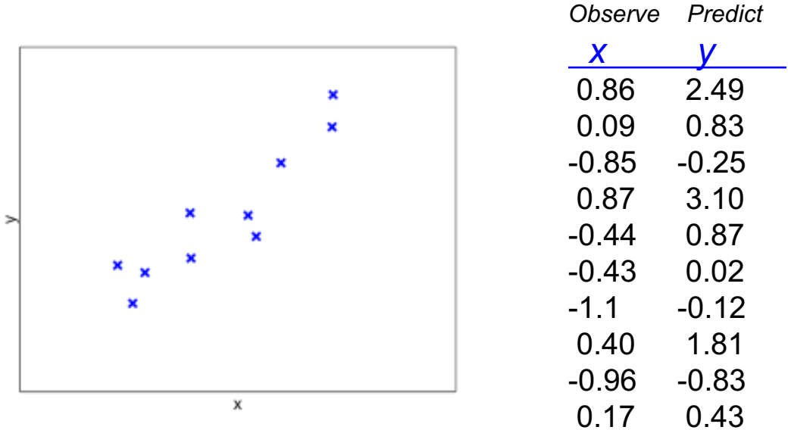
Numerical Example

Slide 16
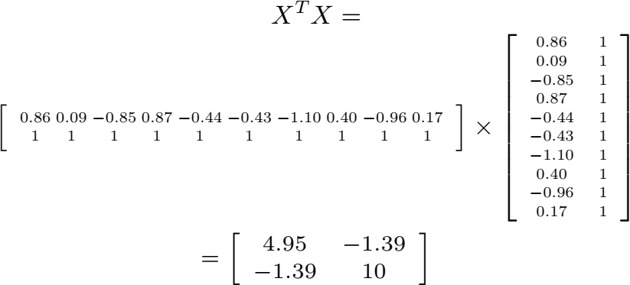
Numerical Example

Slide 17
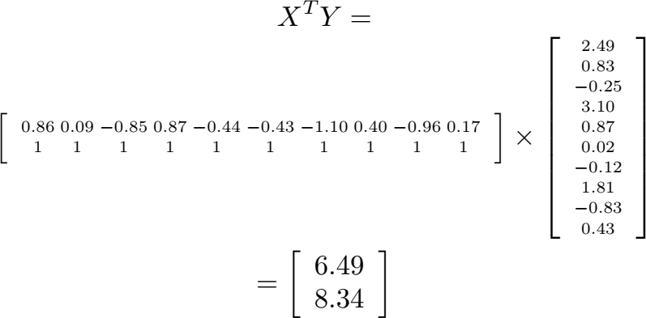

Slide 18
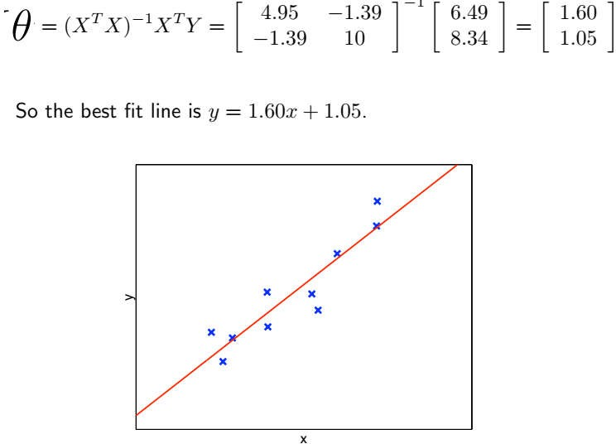

Slide 19
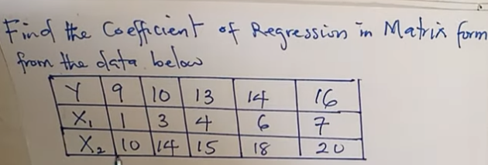
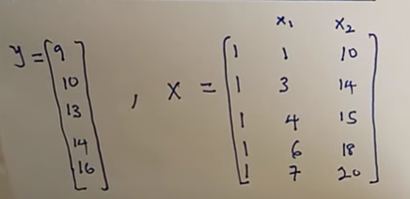
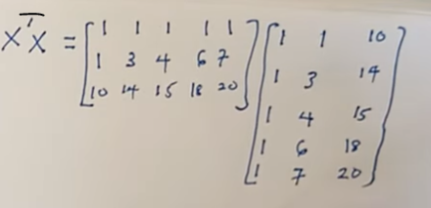
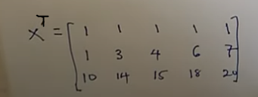
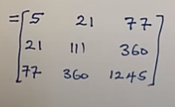
Numerical Example 2

Slide 20
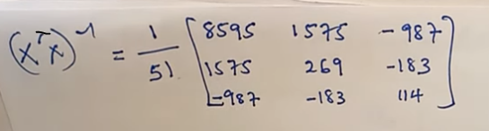
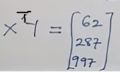
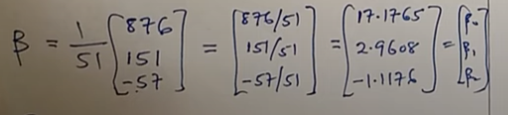
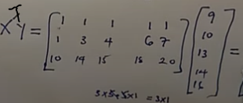


Slide 21
Computational cost of OLS
What operations are necessary?
– Overall: 1 matrix inversion + 3 matrix multiplications
What if X is too big to compute this explicitly (e.g. m ~ 10⁶)?
Assuming for now that X is reasonably small so computation and memory are not a problem. Can we always evaluate this?
To have a unique solution, we need XTX to be nonsingular.

Slide 22
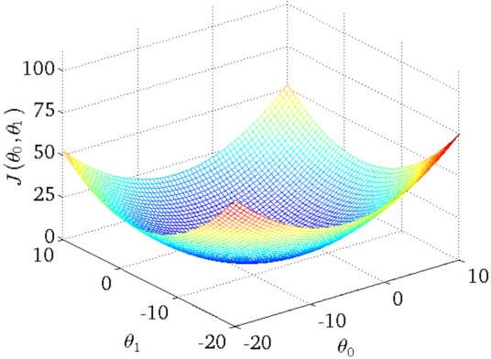
Optimization Objective of Linear Regression

Slide 23
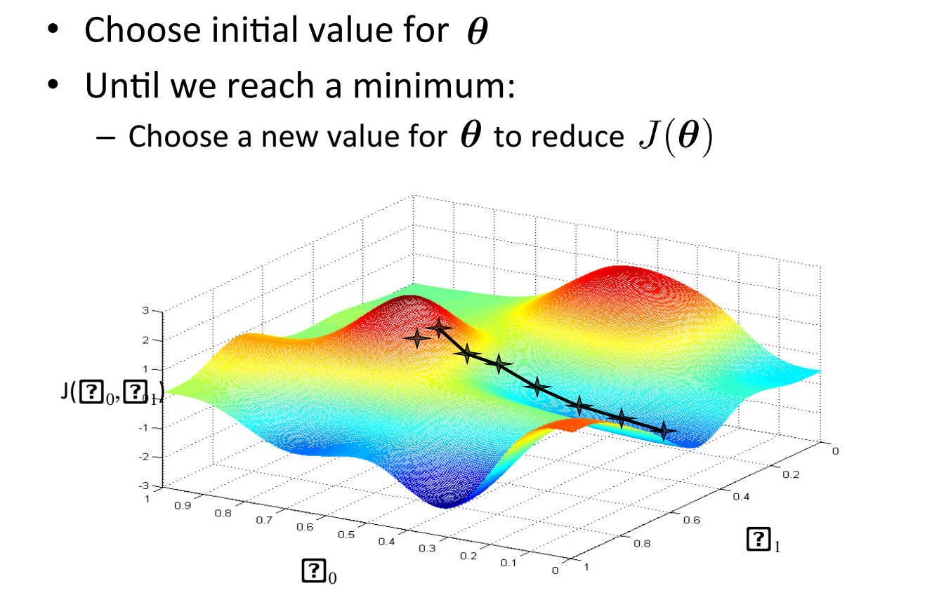
Search Algorithm
Instead of directly finding that minimum (using the closed-form equation), we can take small steps towards the minimum

Slide 24
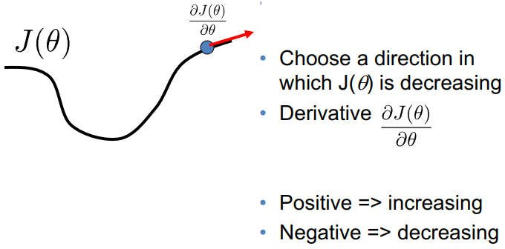
How to choose direction of search?
Gradient is the rate of change of a function. It’s a vector (a direction to move) that
Points to the direction of greatest increase of a function
Is zero at a local maximum or local minimum (because there is no single direction of increase)

Slide 25
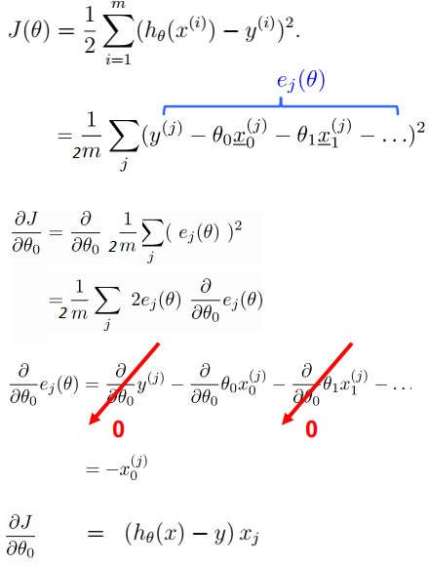
Gradient of Cost Function

Slide 26
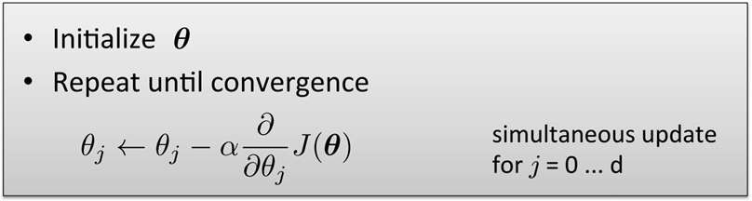
Gradient Descent Algorithm
Gradient descent is an iterative optimization algorithm
It starts with a “guess” θ⁰.
It uses the gradient ∇ J( θ⁰) to generate a better guess θ⁰.
It uses the gradient ∇ J(θ¹) to generate a better guess θ¹.
It uses the gradient ∇ J(θ¹) to generate a better guess θ¹.
…
The limit of θ^{t} as ‘t’ goes to ∞ has ∇ J(θ^{t}) = 0.
It converges to a global optimum if ‘J’ is “convex”.

Slide 27
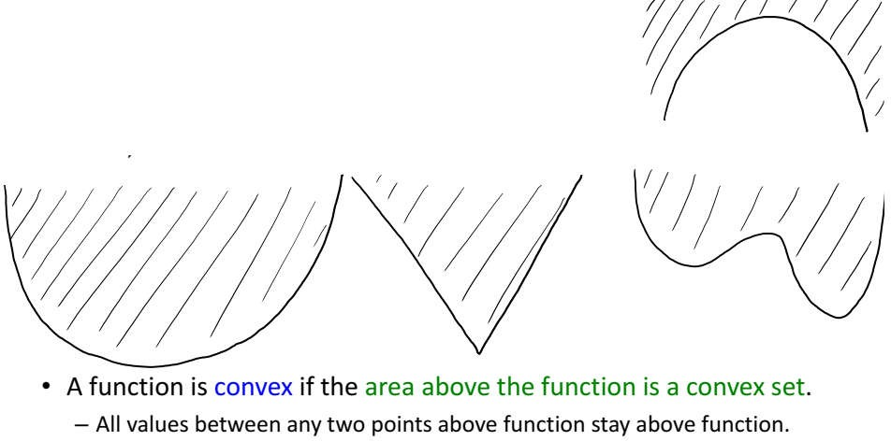
Convex Functions

Slide 28
How do we know if a function is convex?
Some useful tricks for showing a function is convex:
1-variable, twice-differentiable function is convex iff f’’(w) ≥ 0 for all ‘w’.
A convex function multiplied by non-negative constant is convex.
Norms and squared norms are convex.
The sum of convex functions is a convex function.
The max of convex functions is a convex function.
Composition of a convex function and a linear function is convex.
not true that multiplication of convex functions is convex:
– If f(x)=x (convex) and g(x)=x2 (convex), f(x)g(x) = x3 (not convex).

Slide 29
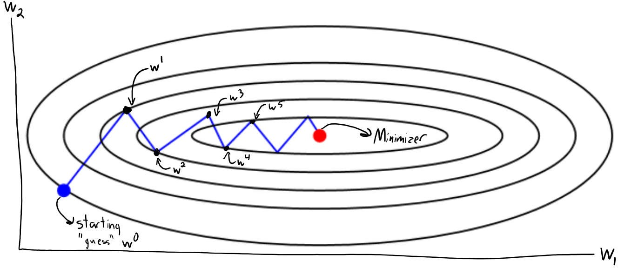
Gradient Descent Summary

Slide 30
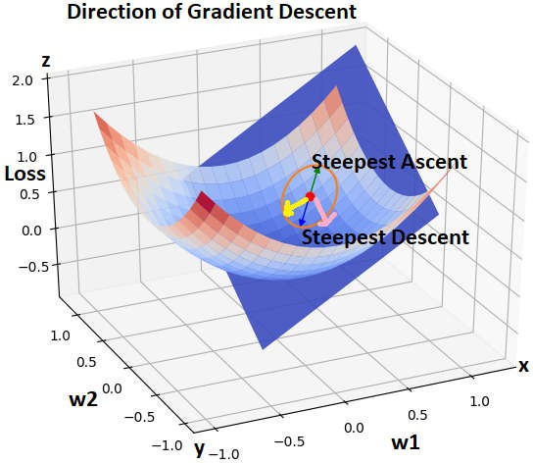

Gradient Descent: Review
Assume we have only two parameters
Optimization is finding parameters for which the value of cost function is minimum
Find the parameters at the bottom most point the function
This direction of ascent is given by the Gradient at that point.
Exact opposite of that give direction of descent
decide the size of the step to take

Slide 31





Gradient descent Algorithm
initialize the model parameters with some random values.
Measure how the cost function changes with change in it’s parameters.
compute the partial derivatives of the cost function w.r.t to the parameters θ₀, θ₁, … , θₙ
similarly, the partial derivative of the cost function w.r.t to any parameter can be denoted by
3. After computing the derivative we update the parameters as given below
repeat the steps 2,3 until the cost function converges to the minimum value

Slide 32
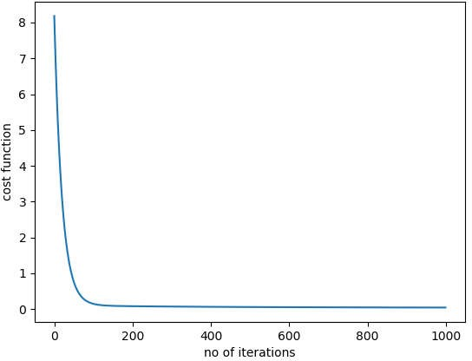
Convergence of cost function

Slide 33
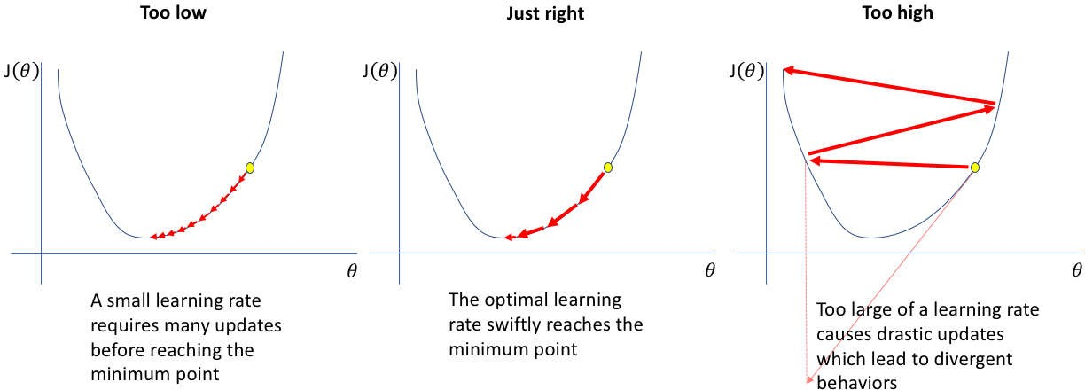
Impact of learning rate

Slide 34

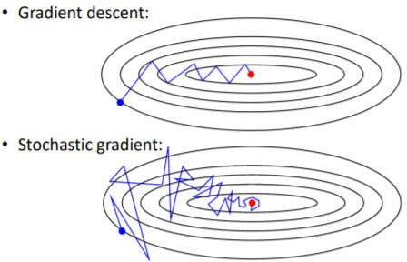
Variants of Gradient Descent
Batch Gradient Descent
Stochastic Gradient Descent
Mini Batch Gradient Descent

Slide 35


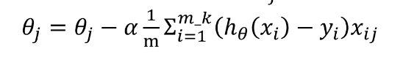
Variants of Gradient Descent
Batch Gradient Descent
Stochastic Gradient Descent
Mini Batch Gradient Descent

Slide 36
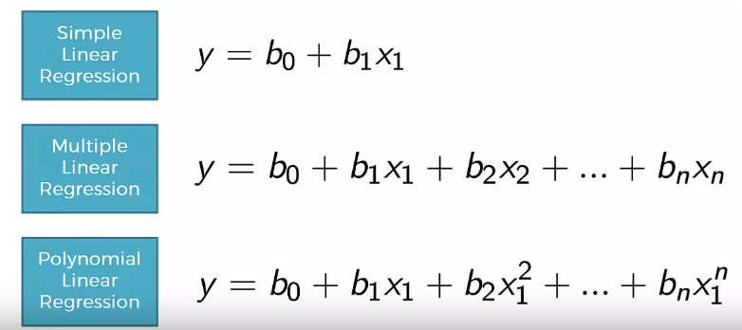
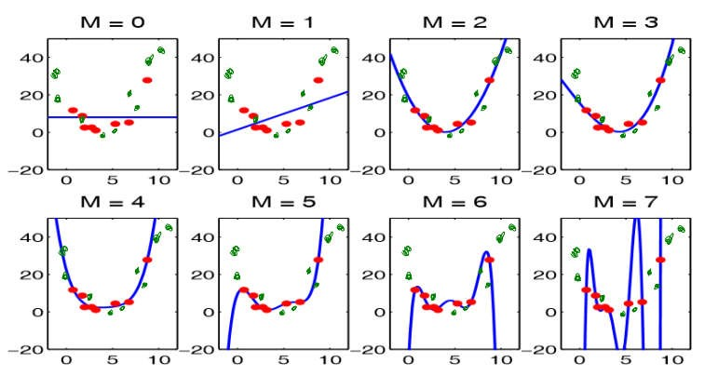
Types of Regression Models

Slide 37
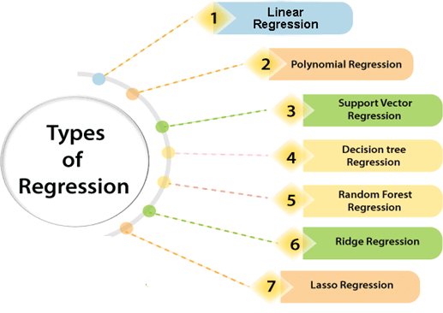
Types of Regression Models

Slide 38

Evaluating the performance of the model

Slide 39

Summary Linear Regression
Hypothesis representation
Ordinary Least Square Estimation
Cost function and Properties
Gradient Descent Algorithm
Finding direction of minimum
Impact of learning rate
Variants of Gradient Descent Algorithm
Performance evaluation
Implementation in scikit

Slide 40
References
Kevin P. Murphy, “Machine Learning, a probabilistic perspective”, The MIT Press, 2012
Lecture notes from Stanford http://cs229.stanford.edu/materials.html
https://machinelearning-blog.com/2018/01/24/linear-regression/

